Slide 1
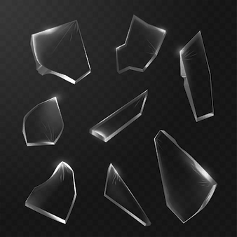
Breaking the Glass Ceiling: Looking at Glass Type Classification
Team Members: Heather Leighton-Dick , Madison Massie , Nasiba Adilova

Slide 2
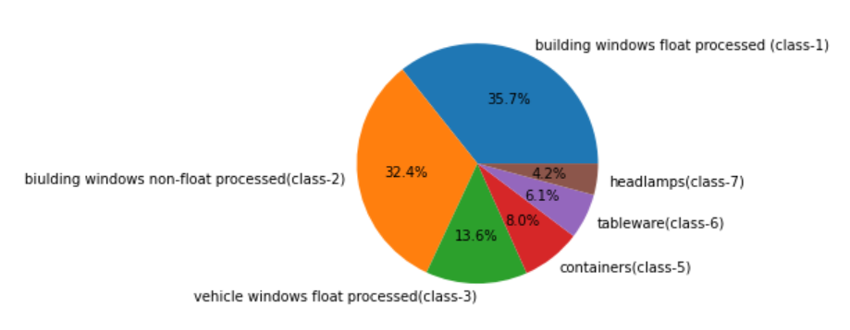






Introduction: Types of Glass
7 Types of Glass in 214 observations:
Class 1: building windows (float processed)
Class 2: building windows (non-float processed)
Class 3: vehicle windows (float processed)
Class 4: vehicle windows (non-float processed)
Class 5: containers
Class 6: tableware
Class 7: headlamps
Window Glass: 76%
Float Glass: 41%
Non-Float Glass: 35%
Non-Window Glass: 24%

Slide 3
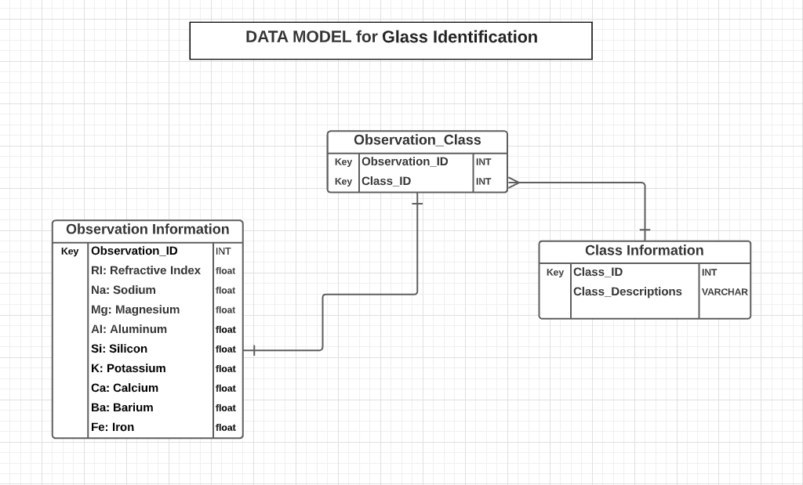
Introduction: Data Model
Data Model
Notes:
Dataset was broken into three distinct tables
Observation Information table contains information about all observations in our dataset and their features
These features will be used to train the model and predict glass types
Class Information table contains all 7 glass types or classes
Class Information is primarily reference information that is used to lookup class_descrpiption based on class_id
Class_Description does not impact our model
Observation_Class is a service table that was created to link observations to the class types
Observation_Class table only contains Primary Keys for both Observations and Classes

Slide 4

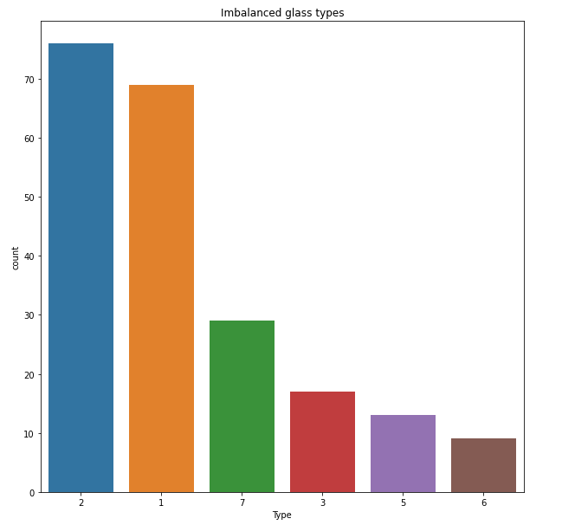
Introduction: Data Cleaning
Remove duplicates
Check for N/As and Nulls
Rename the data columns for better understanding
Imbalanced glass types

Slide 5
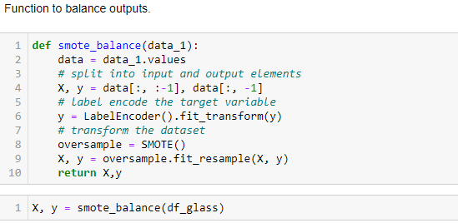
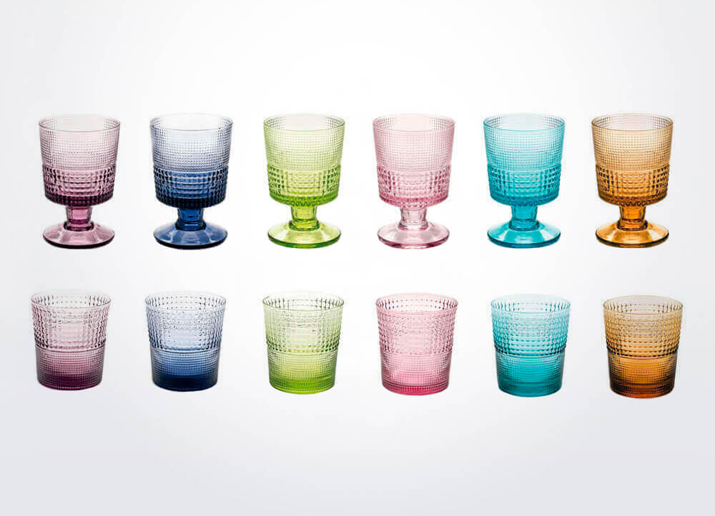
Aiming for a more balanced dataset with SMOTE
SMOTE helps balance data and counteract overfitting by creating new data points in minority classes based on data points within the set. Since type 4 did not have any representative observations in the original dataset, SMOTE did not assign any new data points to that class.
Notes:
Heather

Slide 6
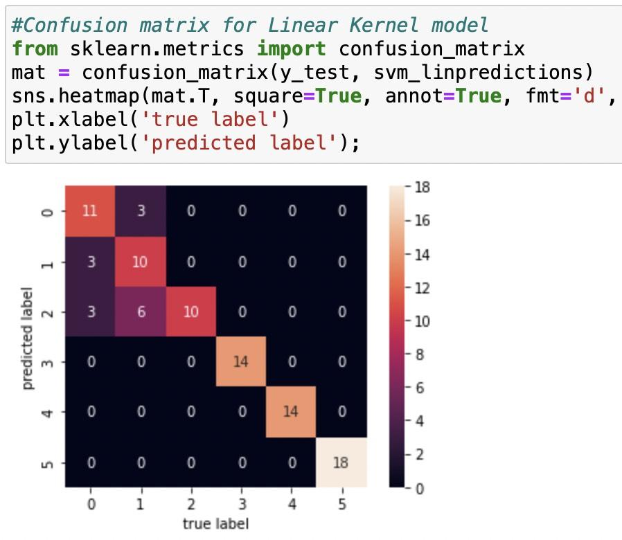
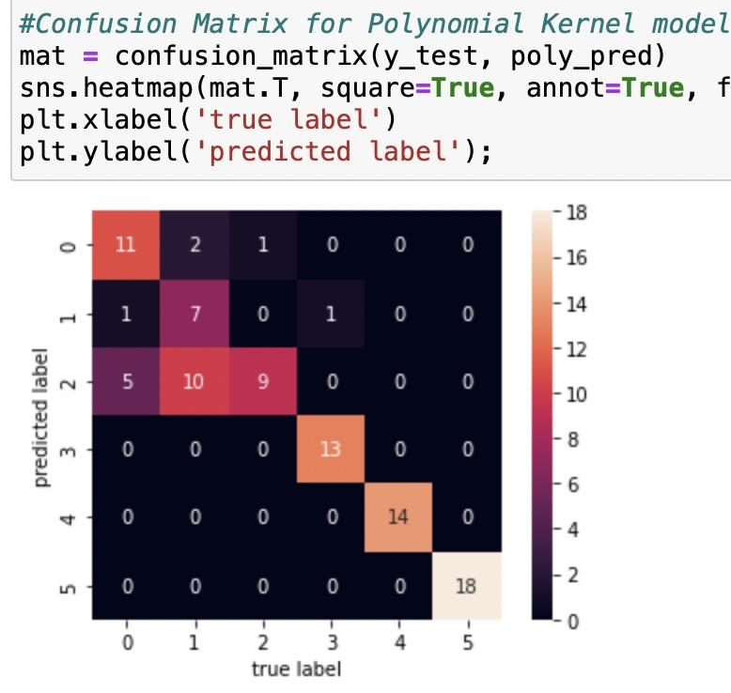
SVM Models: Confusion Matrices
• High correlation across models
• Linear & Polynomial had more trouble predicting Types 1, 2, and 3 than RBF

Slide 7
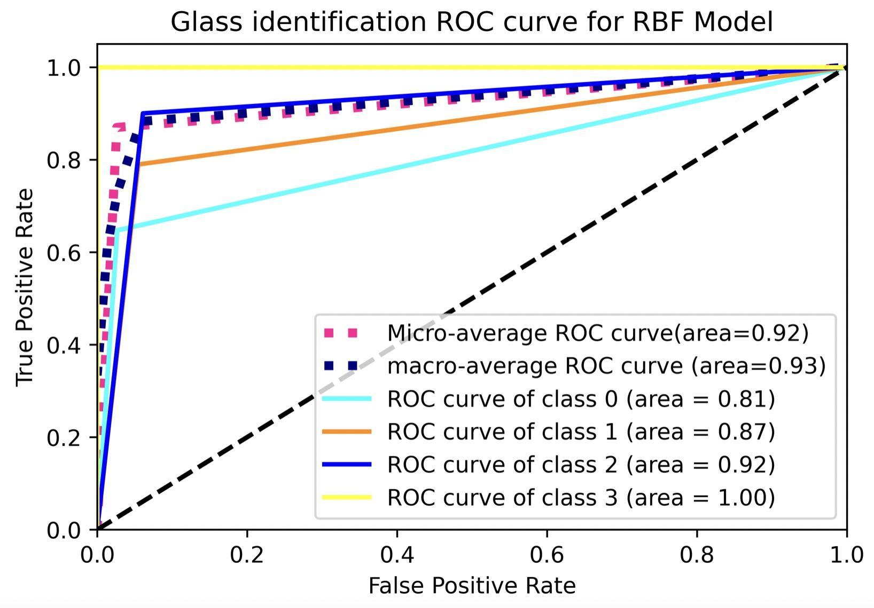
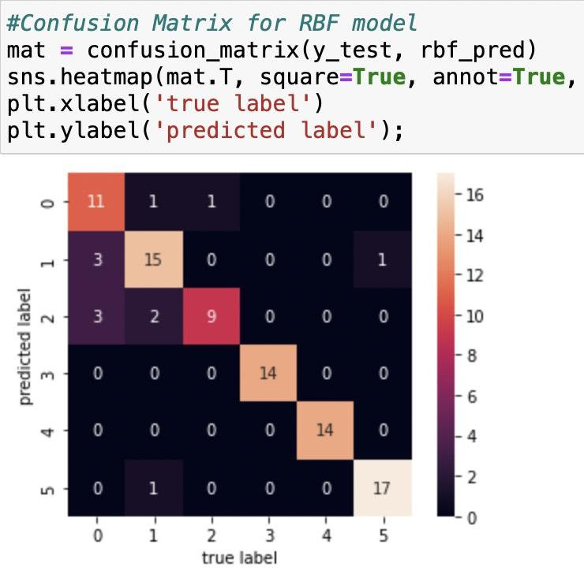
SVM Models: Radial Basis Function

Slide 8

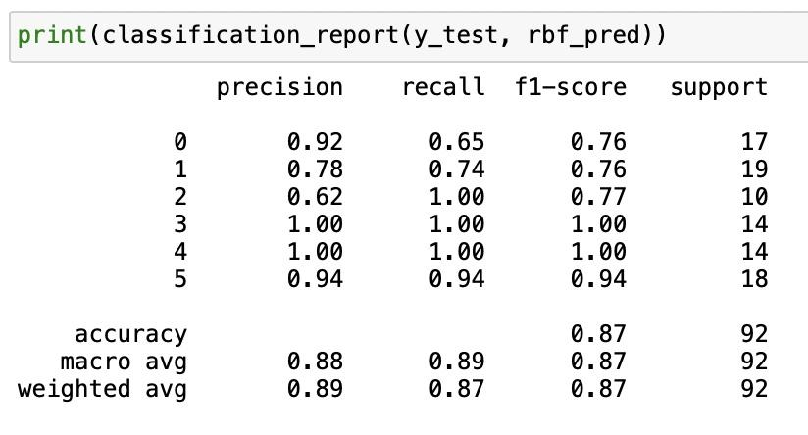
SVM Models: Why did RBF perform best?
Looks at all the data points in the feature space but accounts for points that are farther from the “center” point
RBF works well for smaller datasets because of the way it calculates the distances between points

Slide 9
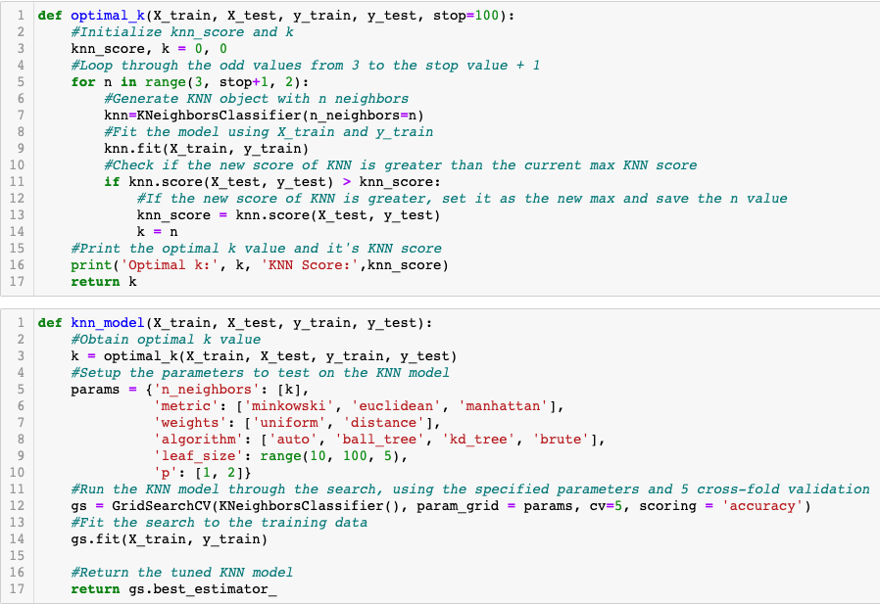
KNN Model

Slide 10
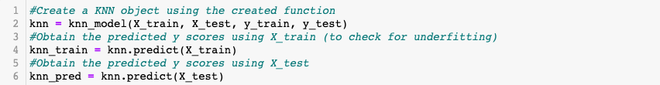
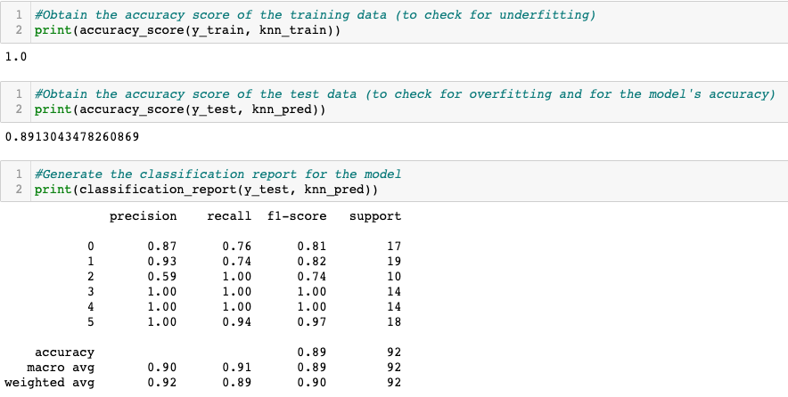

Slide 11
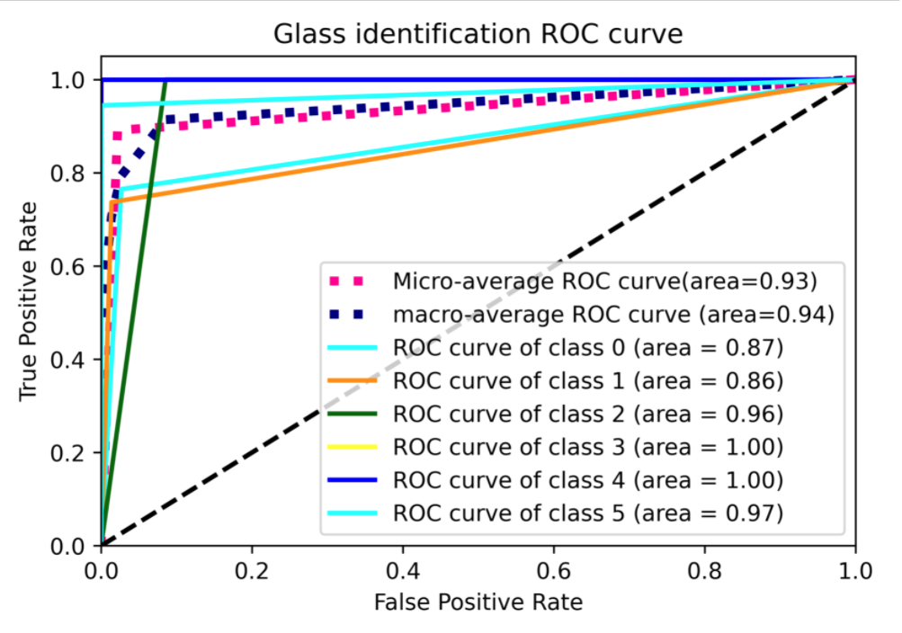

Slide 12
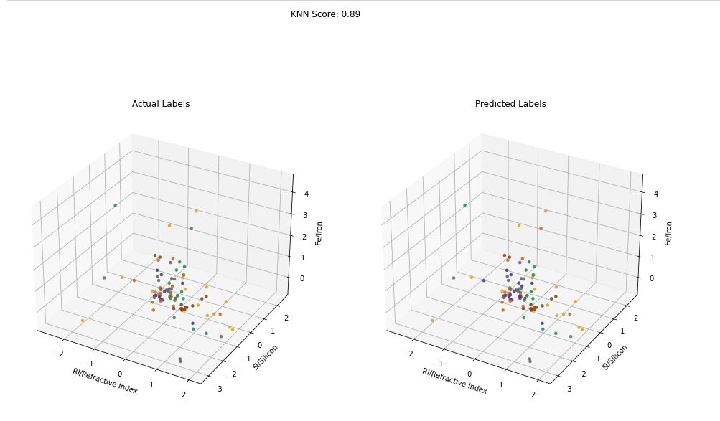

Slide 13
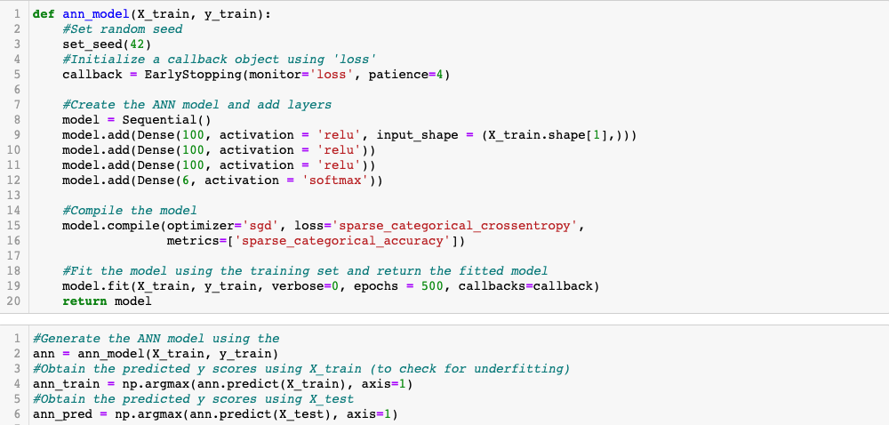
ANN Model

Slide 14
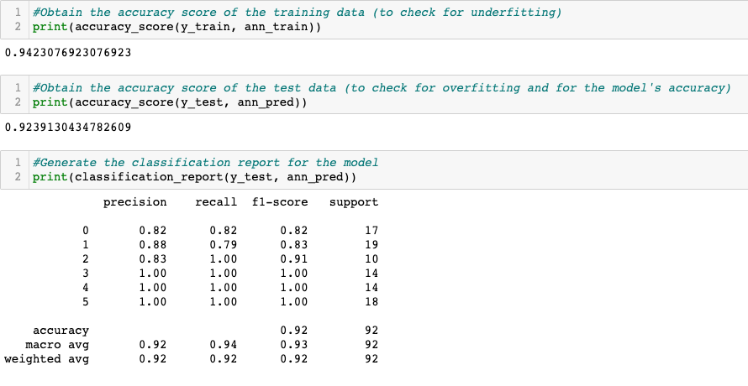

Slide 15
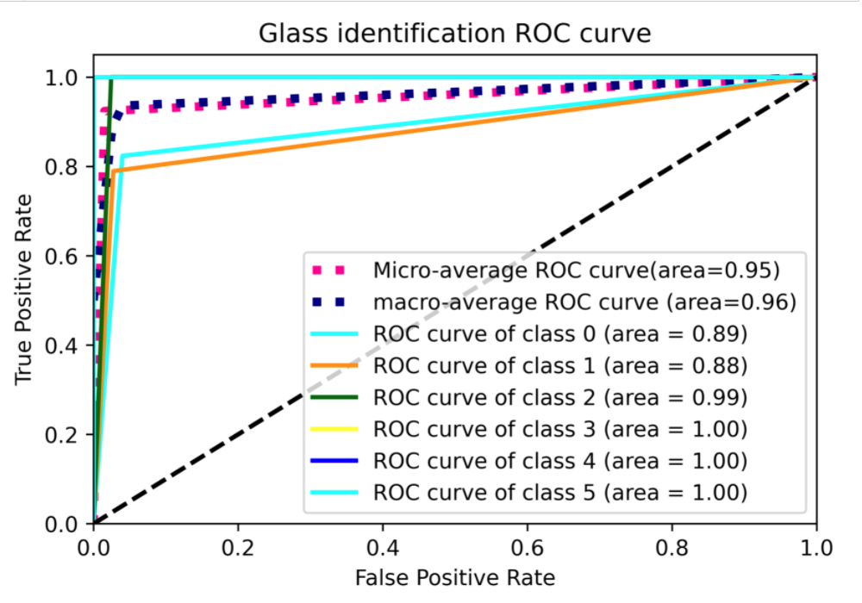

Slide 16
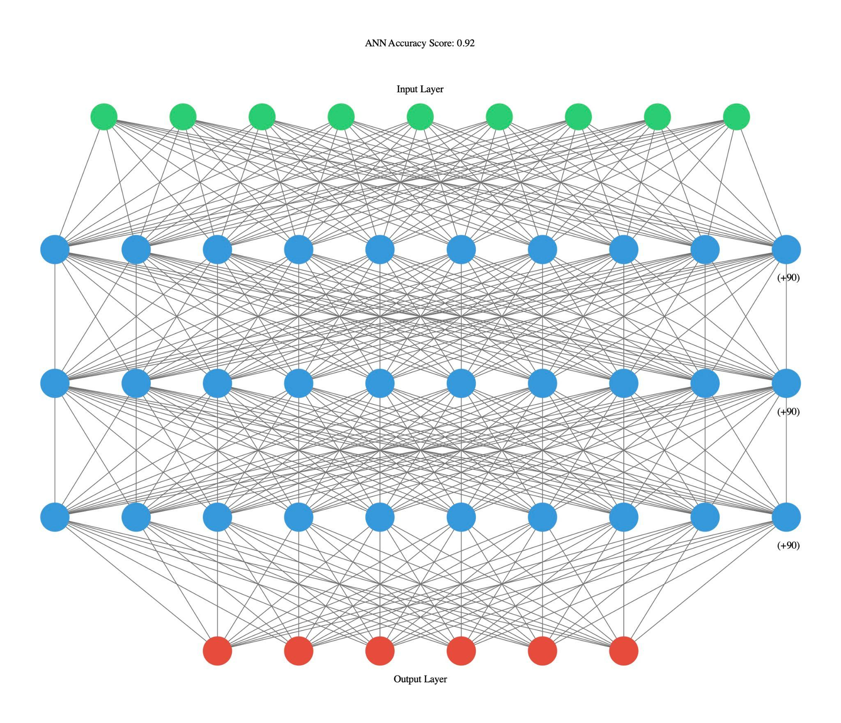

Slide 17
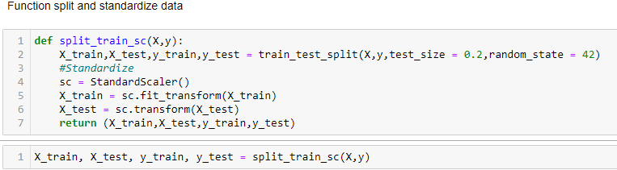
Random Forest Classifier:

Slide 18
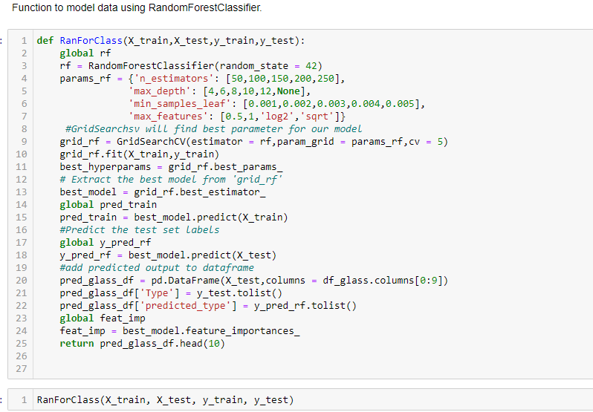

Slide 19
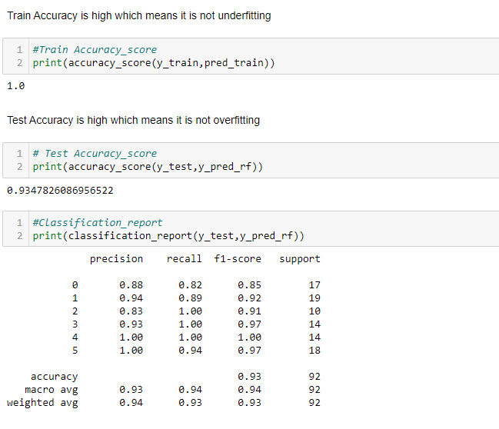

Slide 20
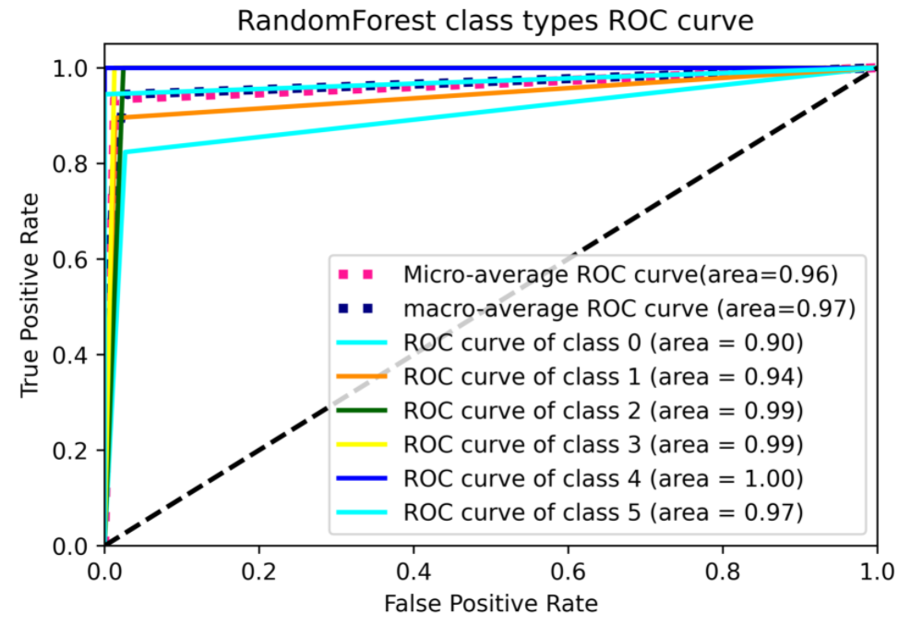

Slide 21
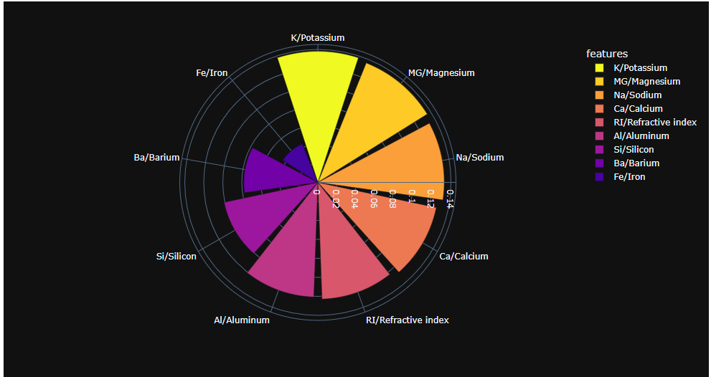
Random Forest Classifier:
Feature Importance

Slide 22

Lessons Learned:
Functions make the code reusable
Global variables can be defined in functions and used outside of the functions
Using different modeling methods and comparing them against each other can help achieve better results
Certain models, like KNN and SVM can be difficult to visualize when they have more than 2-3 features
The were no examples of Type 4, research showed that Type 4 is typically made through a non-float process which is less common now and largely absent from commercial production, so we decided to ignore the class and focus our predictions on the other types of glass

Slide 23

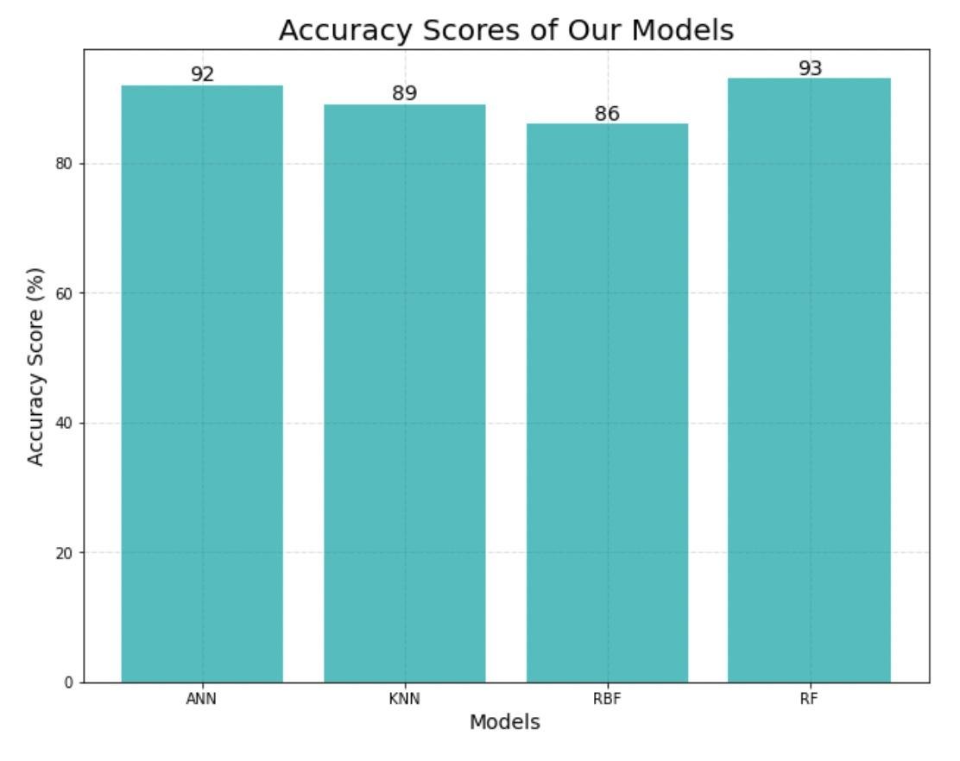
Conclusions
Random Forest was the best classification method of all the models we tried, although the Neural Network did well too.
Glass is an integral part of our lives, and so is the ability to classify it based on its physical and chemical properties.

